Slide 1


Section 508 Refreshed: Key Things You Need To Know!
Bruce Bailey and Katie Haritos-Shea #CSUNATC18

Slide 2
Agenda
Accessibility and the U.S. Government 101
Why Section 508 + WCAG is Better than WCAG Alone
Pay Attention to Definitions
Overview of the Revised Standards
What About Mobile?
Authoring Tools
What Has to Meet all 38 SCs? What Only Has to Meet 34 SCs?
Recap, Resource Links, Contacts, and Questions
Procurement Considerations (if time allows)

Slide 3
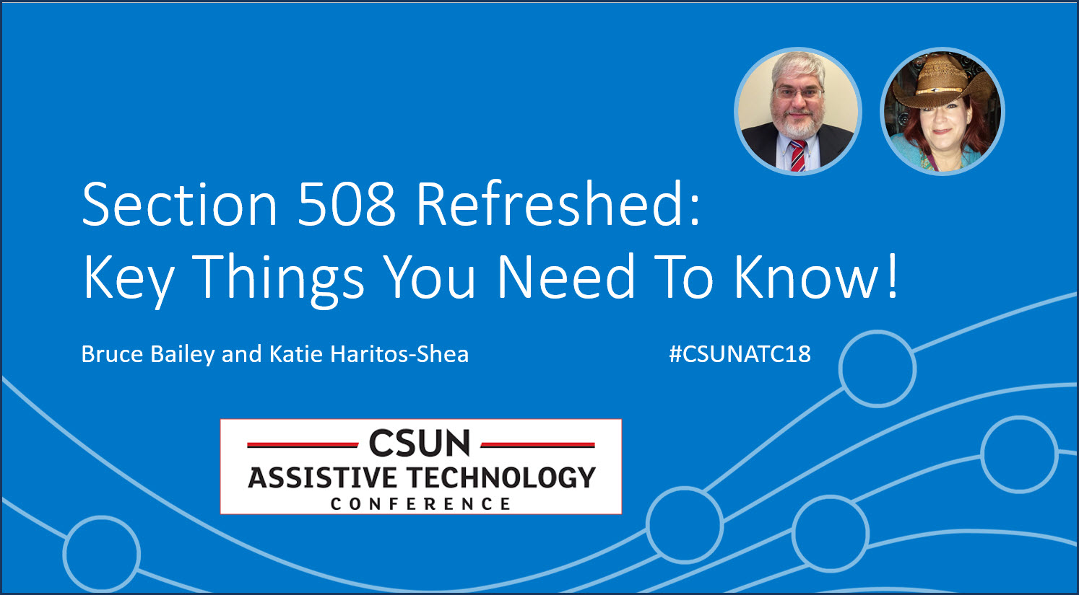
These Slides
Get these presentation slides here: www.deque.com/csun18

Slide 4

Acronyms & Abbreviations
AOC = Agency Official Communications
AT = Assistive Technology
FAR = Federal Acquisition Regulations
FPC = Functional Performance Criteria
IBR = Incorporated by Reference
ICT = Information and Communication Technology
SC = Success Criteria
SW = Software
WCAG = Web Content Accessibility Guidelines

Slide 5

Accessibility and the U.S. Government 101

Slide 6
Landmark Disability and Civil Rights Laws
Rehabilitation Act (Sections 508, 504, 501, 503)
Section 508: Org. 1973, amendments in ’86 and 98
Prohibits discrimination on the basis of disability in programs conducted by Federal agencies, in programs receiving Federal financial assistance, in Federal employment, and in the employment practices of Federal contractors
Enforcing Agencies: GSA, DOJ, ED, HHS, DOL, DHS and more
The Architectural Barriers Act (ABA) (Org. 1968)
Requires access to facilities designed, built, altered, or leased with Federal funds
Americans with Disabilities Act (ADA) 1990 (Title II-State&Local Gov/Title III-Public Accommodations)
Prohibits discrimination on the basis of disability in employment, state and local government programs, public accommodations, commercial facilities, transportation, and telecommunications
Enforcing Agencies: EEOC, DOJ, DOT, FCC, + (Comprehensive Civil Rights Law)
Communications Act (Section 255) 1934 (Org. 1934)
Requires Telecommunications companies and service providers to make their products /services accessible to PWD
Enforcing Agency: FCC
Communications and Video Accessibility Act (CVAA) 2010
Increases Access to Modern Communications by Persons With Disabilities.
TV, DVD, IPTV, Video, VoIP, Conferencing, Messaging, Mobile Browsers
Enforcing Agency: FCC
Notes:
508: Section 508 was originally added as an amendment to the Rehabilitation Act of 1973 in 1986. ... In the end, this Federal Electronic and Information Technology Accessibility and Compliance Act, with revisions, was enacted as the new Section 508 of the Rehabilitation Act of 1973, in 1998.
ABA: Architectural Barriers Act (ABA) of 1968. President Lyndon Johnson, who signed the ABA into law in August 1968, characterized barriers to access as a failure on the part of government that perpetuated “cruel discrimination.” The ABA requires access to facilities designed, built, altered, or leased with Federal funds.
Telecom: Signed into law by President Bill Clinton on Feb. 8, 1996, it was the first major revision of telecommunications regulation since the passage of the original Communications Act of 1934, which established the Federal Communications Commission and gave it jurisdiction over broadcasting and telephony.
Acronyms & Abbreviations:
?? = ??
?? = ??
?? = ??

Slide 7

Rehabilitation Act
Section 501
Prohibits Discrimination in Federal Employment (in hiring, placement, and advancement opportunities) Requires Reasonable Accommodation
Section 504
Section 508
Governs Federal IT System & Infrastructure Accessibility
Requires Electronic (& Comparable) Access to ICT, Information & Data
Prohibits Discrimination in Government, Education, and Public Services
Requires User Accessibility & Providing Auxiliary Aids
Section 502
Created and Directs the U.S. Access Board to Develop Access Standards and Guidelines (for Section 508, ABA, ADA, etc.)
Enforced by each Agency 508 Office, DOJ, & OMB
Enforced by each Agency EEO Office, and EEOC
Enforced by each Agency OCR Office, and OCR DOJ
7
Notes:
Enforcement: Office of Civil Rights at the agency that provided the funds, or to the U.S. Department of Justice, Civil Rights Division, Coordination and Review Section, P.O. Box 66118, Washington, DC, 20035-6118 or use the form at: https://www.ada.gov/t2cmpfrm.htm.
Enforcement in Education: Office of Civil Rights OCR, a component of the U.S. Department of Education, enforces Section 504 of the Rehabilitation Act of 1973, as amended, (Section 504) a civil rights statute which prohibits discrimination against individuals with disabilities - for educational related complaints only.
Acronyms & Abbreviations:
ADA = Americans with Disabilities Act
DoJ = Department of Justice
OCR = Office of Civil Rights
OMB = Office of Management and Budget

Slide 8
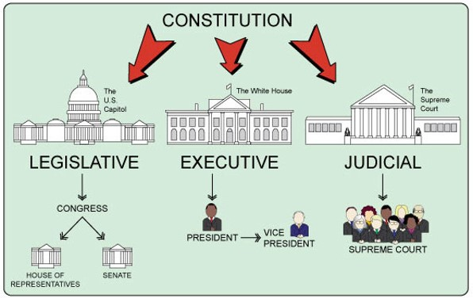
Creating Laws and Regulations: 3 Branches of Gov
Legislative: Write the Laws (Congress [Senate & House of Rep.])
Executive: Implement the Laws, by Writing/Enforcing Regulations (Departments, Agencies, President and Vice President)
Judicial: Interpret the Laws (Courts)
Notes:
State and Local Governments Laws and Regulations come after Federal Laws and Regulations in precedence. In this order Federal, then State, then Local.
This more of WHO is responsible for WHAT as far as creating, implementing and defending the laws and regulations go.
Legislative: Make the Laws – ADA, ACAA, Rehabilitation Act, CVAA (US Congress (Senate and House of Representatives.) - and agencies that support Congress [Congressional Budget Office (CBO), Government Accountability Office (GAO), Government Printing Office (GPO)
Library of Congress (LOC)])
Executive: Enforce the Laws, Write & Enforce Regulations (Rules) – FAR, Standards (President/Vice President, Departments, Agencies)
Judicial: Interpret the Laws (and Constitution) (Courts, Court System)
Acronyms & Abbreviations:
ACAA = Air Carrier Access Act
LOC = Library of Congress
GAO = Government Accountability Office
FAR = Federal Acquisition Regulations
GPO = Government Printing Office
VP = Vice President

Slide 9
Hierarchy of Section 508 Authority
Law: Section 508 of the Rehabilitation Act (as Amended)
29 U.S.C. § 794d
508 Standards Rule: Implementing REGULATION of the Law
Law mandates Access Board to define and update EIT/ICT Accessibility Standards for Section 508 - 36 CFR Part 1194
508 FAR Rule: Implementing REGULATION of the Law
Law mandates FAR Council to update Section 508 Standards included in (and therefore ENFORCED through) the FAR, with-in 6 months of publication of any UPDATED standards in the Federal Register
508 Department/Agency Policy: Procurement, ICT and ICT Docs
Law mandates Agencies to revise/update their Acquisition Process with-in 6 months of any UPDATED Standards for Section 508 that are published in the Federal Register
Write/update any ICT documentation with NEW standards AND write/update any agency regulations implementing the Law/Rules
Notes:
We talked about ‘WHO is responsible for WHAT’ within the US Government concerning Section 508 and accessibility oversight. I want to touch on the Overall Authority of the Law, and what is proscribed in it – in more general terms and implementation steps.
LAW - Section 508 of the Rehabilitation Act
29 U.S.C. § 794d
STANDARDS - Implementing REGULATION of the LAW
LAW mandates U.S. Access Board to create and update EIT/ICT Standards for Section 508 Electronic and Information Technology Accessibility Standards (Section 508) ICT = Information and Communications Technology Architectural Transportation and Compliance Board, 1973
Independent Micro-Agency (29 staff)
FAR 508 RULE - Implementing REGULATION of the LAW
LAW mandates Section 508 STANDARDS clause be included in, and, therefore ENFORCED through the Federal Acquisition Regulation (FAR)
Agency Procurement & Policy Documents
LAW mandates Agencies MUST update their Acquisition Process with-in 6 months of NEW or UPDATED 508 Standards being published in the Federal Register (2018 Federal Register (82 FR 5790) )
Acronyms & Abbreviations:
ICT= Information and Communications Technology
EIT = Electronic and Information Technology
USC (U.S.C.) = United States Code

Slide 10

Why Section 508 + WCAG is Better than WCAG Alone

Slide 11
Plain WCAG 2 vs. Revised Section 508
There is Law that specifies Web and ICT Accessibility
WCAG provides a way to measure Accessibility
Section 508 goes far beyond websites; 508 requires that agencies provide Accessible:
hardware (PCs, kiosks) and telecom (smart) devices
ICT platforms and infrastructure
software, OSs and applications (including mobile)
ICT support and services (help desks, call centers)
official agency communications and email
media, multimedia, social media and browsers
ICT authoring tools (Word, Dreamweaver, blogs)
training and training materials
Notes:
Acronyms & Abbreviations:
ICT = ??
OS = ??
?? = ??

Slide 12

US Gov is World’s Largest Single Purchaser of ICT !!
That fact is why Section 508 drives the ICT Industry to provide Accessible products and services
U.S. Section 508 requirements drive standards, innovation and personalization in ICT Worldwide
Notes:
Acronyms & Abbreviations:
?? = ??
?? = ??
?? = ??

Slide 13

The New 508 Right Stuff!
Requires 508 ICT to ensure accessibility and usability (E101.1 Purpose & E203.1 Access to Functionality)
Requires and Expands Interoperability with AT (502)
Requires authoring tools to be user accessible and provide accessible content (504)
Notes:
Acronyms & Abbreviations:
?? = ??
?? = ??
?? = ??
255 already had Usability Requirements – 508 did not

Slide 14
The New 508 Right Stuff for Users!
Requires agencies to identify needs of users with disabilities when beginning ICT efforts
E203.2 User Needs: Requires when agencies procure, develop, maintain or use ICT, they shall identify how:
users will perform supported functions
ICT will be developed, installed, configured and maintained to support users with disabilities
Notes:
Acronyms & Abbreviations:
?? = ??
?? = ??
?? = ??
603 Support Services
603.1 General. ICT support services including, but not limited to, help desks, call centers, training services, and automated self-service technical support, shall conform to 603.
603.2 Information on Accessibility and Compatibility Features. ICT support services shall include information on the accessibility and compatibility features required by 602.2.
603.3 Accommodation of Communication Needs. Support services shall be provided directly to the user or through a referral to a point of contact. Such ICT support services shall accommodate the communication needs of individuals with disabilities.

Slide 15
More New Right Stuff for Users!
602 Support Documentation & 603 Support Services
Requires agency ICT support services (help desks, call centers, training services, and auto. self-service technical support) to provide for users:
Documentation that explains ‘how to use’ the required (602.2) and accessible (602.3) Accessibility and Compatibility Features (603.2) of ICT
Support for their needs directly to the user or through a referral to a POC (603.3), and, such ICT support services shall Accommodate the Communication Needs of individuals with disabilities
Links to: 602 Support Documentation & 603 Support Services
Notes:
Acronyms & Abbreviations:
?? = ??
?? = ??
?? = ??
255 already had Usability Requirements – 508 did not

Slide 16

Standards are IBR
W3C WCAG 2
Web, Documents, Software, Support Documentation
ANSI/HFES 200.2 2008 (Part 2: Accessibility)
Platforms, Platform Software (OS, Media Players, Browsers)
PDF/UA
Authoring Tools, 504.2.2 PDF Export
Notes:
Acronyms & Abbreviations:
W3C = ??
WCAG = ??
ANSI = ??
HFES = ??
PDF = ??
UA = ??
?? = ??

Slide 17

Pay Attention to Definitions

Slide 18

508 Standard Definition: ICT
Information and Communication Technology (ICT)
IT and other equipment, systems, technologies, or processes, for which the principal function is the creation, manipulation, storage, display, receipt, or transmission of electronic data and information, as well as any associated content.
Examples of ICT:
computers / peripheral equipment
information kiosks and transaction machines
telecommunications equipment
customer premises equipment
multifunction office machines
software
applications
Web sites
videos
electronic documents
Notes:
Acronyms & Abbreviations:
?? = ??
?? = ??
?? = ??

Slide 19

Definition of Software (508/255)
Software
Programs, procedures, rules, and related data and documentation that direct the use and operation of ICT and instruct it to perform a given task or function
Software includes, but is not limited to:
applications
non-Web software
platform software
Notes:
This definition in included in both 508 E103 and 255 C103
Acronyms & Abbreviations:
?? = ??
?? = ??
?? = ??

Slide 20

Platform Software Definition (508/255)
Platform Software
Software that interacts with hardware or provides services for other software
Platform software may run/host other software, and may isolate them from underlying software or hardware layers
A single software component may have both platform and non-platform aspects
Examples of platforms:
desktop operating systems
embedded operating systems, including mobile systems
Web browsers
plug-ins to Web browsers that render a particular media or format
sets of components that allow other applications to execute, such as applications which support macros or scripting
Notes:
Acronyms & Abbreviations:
?? = ??
?? = ??
?? = ??

Slide 21

Definition of Application (508/255)
Application
Software designed to perform, or to help the user to perform, a specific task or tasks
(Smaller scope than the Software definition. It is Sub-set of software.)

Slide 22

(Electronic) Content Definition (508/255)
Content
Electronic information and data
as well as - the encoding that defines its structure, presentation, and interactions

Slide 23

Definition of Document (508/255)
Document
Logically distinct assembly of content (such as a file, set of files, or streamed media) that: functions as a single entity rather than a collection; is not part of software; and does not include its own software to retrieve and present content for users
Examples of documents include, but are not limited to:
letters
email messages
spreadsheets
presentations
podcasts
images
movies
Notes:
Acronyms & Abbreviations:
?? = ??
?? = ??
?? = ??

Slide 24

Two Other 508 Definitions
Non-Web Documents
Document that is not:
a Web page
embedded in a Web page
used in rendering pages
Non-Web Software
Software that is not:
a Web page
embedded in a Web page
used in rendering pages
used in functioning of Web pages
Notes:
Example of Non-web Software: Desktop software (Word, Excel). Example of Non-Web Document: documents on servers, documents on desktop (not 365 etc).
Acronyms & Abbreviations:
?? = ??
?? = ??
?? = ??

Slide 25

Which Begs the Question …..
What is Web Software?
Web-software or web-app is a client/server application that runs in a web browser via http/https.
Does not need to be installed. It only requires an internet connection.
Examples: Office 365, Facebook, GMAIL, SharePoint Online/Cloud
Notes:
Browser-based applications only require an internet connection and an installed web
browser on your computer to function. Web application or web app is a client–server computer program in which the client (including the user interface and client-side logic) runs in a web browser.

Slide 26
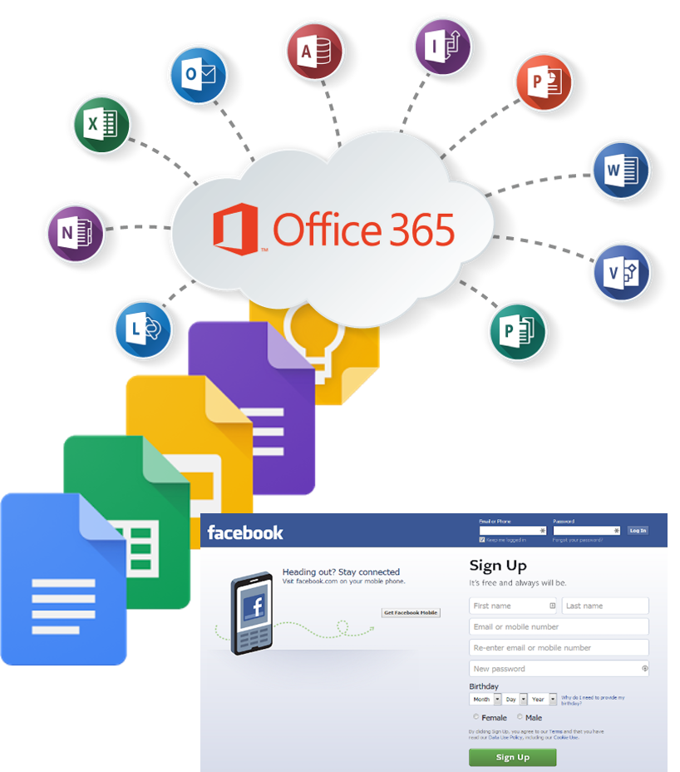
…. and this Question …
What is a Web Document?
Document that runs in a web browser via http/https
Examples: Google Docs, Office 365 documents, media
Web page
Any document embedded in a web page
Notes:
Acronyms & Abbreviations:
?? = ??
?? = ??
?? = ??

Slide 27

Overview of the Revised Standards

Slide 28

Revised 508/255: Appendices & Chapters
Organized by 3 Appendices and 7 Chapters:
Application & Administration (508 & 255)
Scoping Requirements (508 & 255)
FPC
Hardware
Software
Support Documentation & Services
Referenced Standards
Notes:
Slide Owner: Katie

Slide 29
Standard Structure
Appendix A Section 508 of Rehabilitation Act Chapter provisions have an ‘E’ at beginning (E101, etc.). Federal Government
508 Chapter 1: Application and Administration
E101 General
E102 Referenced Standards
E103 Definitions
508 Chapter 2: Scoping Requirements
E201 Application
E202 General Exceptions
E204 Functional Performance Criteria
E205 Electronic Content
E206 Hardware
E207 Software
E208 Support Documentation and Services
Appendix B Section 255 of Communications Act Chapter provisions have an ‘C’ at beginning (C101, etc.). Manufacturers
255 Chapter 1: Application and Administration
C101 General
C102 Referenced Standards
C103 Definitions
255 Chapter 2: Scoping Requirements
C201 Application
C202 FPC
C203 Electronic Content
C204 Hardware
C205 Software
C206 Support Docs and Services
Appendix C Functional Performance Criteria and Technical Requirements Chapter provisions have only numbers – applies to 508 and 255
Chapter 3: Functional Performance Criteria
301 General, 302 FPC
Chapter 4: Hardware
401, 402 Closed Func., 403 Biometrics, …
Chapter 5: Software
501 General
502 Interoperability with AT
503 Applications
504 Authoring Tools
Chapter 6: Support Docs/Services
601 General
602 Support Documentation
603 Support Services
Chapter 7: Referenced Standards
Notes:
Acronyms & Abbreviations:
FPC = Functional Performance Criteria
E208 Support Documentation and Services
E208.1 General. Where an agency provides support documentation or services for ICT, such documentation and services shall conform to the requirements in Chapter 6.
C206 Support Documentation and Services
C206.1 General. Where support documentation and services are provided for telecommunications equipment and customer premises equipment, manufacturers shall ensure that such documentation and services conform to Chapter 6 and are made available upon request at no additional charge.

Slide 30

Exception Changes
Exceptions
Added an important one
E202.2 Legacy ICT (Safe Harbor)
Not retained
AT not required everywhere
Extra locations not required
Notes:
Acronyms & Abbreviations:
?? = ??
?? = ??
?? = ??

Slide 31

FPC: What Was Added?
Revised Section 508 (E204)
302.1 Without Vision
302.2 With Limited Vision
302.3 Without Perception of Color
303.4 Without Hearing
303.5 With Limited Hearing
303.6 Without Speech
303.7 With Limited Manipulation
303.8 With Limited Reach and Strength
303.9 With Limited Language, Cognitive, and Learning Abilities
Notes:
Acronyms & Abbreviations:
?? = ??
?? = ??
?? = ??

Slide 32

FPC (E204): Clarified
FPC Used Only When:
Technical requirements do not address ICT function in:
Chapter 4 (Hardware) or
Chapter 5 (Software)
Assessing claim of Equivalent Facilitation

Slide 33

What is Electronic Content?
Web Sites
Applications
Web Software
Desktop Software
Documents on Web Pages
Documents rendered via Browser
Web Mail
Media Files
Electronic Documents
Email & Email Attachments
Non-Web Documents
Non-Web Software
Streaming Media
Social Media
Mobile Applications
Mobile Documents
Support Documentation
Training & Training Materials
Notes:
Acronyms & Abbreviations:
?? = ??
?? = ??
?? = ??

Slide 34
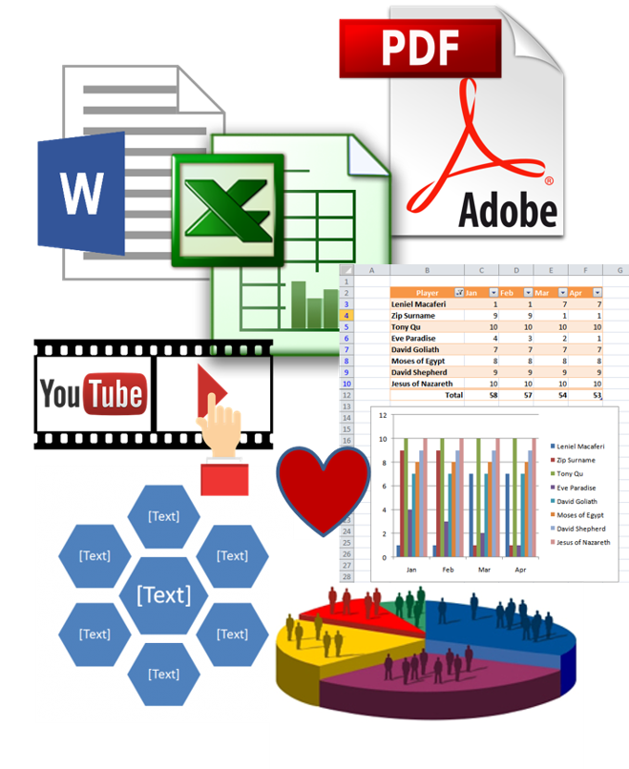
Location & Type of Electronic Content
E205.2 Public Facing
Electronic content that is public facing shall conform…(WCAG 2)
E205.3 Agency Official Communication
Content that is not public facing
Agency official communication in nine categories
Exception for NARA records
Conform to WCAG 2, unless non-Web
Notes:
Acronyms & Abbreviations:
NARA = National Archives and Records Administration
?? = ??
?? = ??

Slide 35
Official Agency Communications
Agency Official Communication (E205.3)
An emergency notification
An initial or final decision adjudicating an administrative claim or proceeding
An internal or external program or policy announcement
A notice of benefits, program eligibility, employment opportunity, or personnel action
A formal acknowledgement of receipt
A survey questionnaire
A template or form
Educational or training materials
Intranet content designed as a Web page
Notes:
Acronyms & Abbreviations:
?? = ??
?? = ??
?? = ??

Slide 36

Software
Interoperability with AT (502)
Accessibility Features & Services (502.1, 502.2)
allow user control and don’t disrupt
Platform Accessibility Features (502.4)
conform ANSI/HFES 200.2
Applications (503)
User Preferences (503.2)
color, contrast, font type, font size, and focus cursor
Alternative UI AT (503.3)
User Controls for Captions and Audio Description (503.4)
same menu level as controls for volume or program
Authoring Tools (504)
Complete Processes (E207.3, C205.3)
Notes:
503.4 User Controls for Captions and Audio Description. Where ICT displays video with synchronized audio, ICT shall provide user controls for closed captions and audio descriptions conforming to 503.4.
503.4.1 Caption Controls. Where user controls are provided for volume adjustment, ICT shall provide user controls for the selection of captions at the same menu level as the user controls for volume or program selection.
503.4.2 Audio Description Controls. Where user controls are provided for program selection, ICT shall provide user controls for the selection of audio descriptions at the same menu level as the user controls for volume or program selection.

Slide 37

What About Mobile?

Slide 38

Platform Software on Mobile
Same for Desktop PC
OS Must provide Accessibility Features (502.2)
If OS is Closed (402)
(can’t add AT)
Must work w/o AT (402.1)
Must conform to Speech Output Enabled (402.2)
Exception in 502.1
If OS is Open
Like a PC would require:
Interoperability with AT (502)
Applications (503)
Authoring Tools (504)

Slide 39

Apps on Mobile
Native Software (Apps)
34 WCAG 2 SCs
Authoring Tools
Web Software (Apps)
38 WCAG 2 SCs
Applications
Authoring Tools
Hybrid Apps (cut your losses….)
38 WCAG 2 SCs
Applications
Authoring Tools

Slide 40

Authoring Tools
Chapter 5: Software (but also covers Web)

Slide 41

ICT Authoring Tools: Web/Software
Authoring Tool
Any software/web, or collection of software/web components, that can be used by authors, alone or collaboratively, to create or modify content for use by others, including other authors (i.e., blogs)
Notes:
Acronyms & Abbreviations:
?? = ??
?? = ??
?? = ??

Slide 42
Examples of ICT Authoring Tools
Software/Web tools used for:
authoring/editing digital content (Word, Excel, PPT, Acrobat, etc.)
converting digital content ("Save as HTML“, “Save as PDF”, etc.)
web content authoring/editing (WYSIWYG HTML: Dreamweaver)
updating portions of web pages (blogs, wikis, online forums)
live collaboration
creating mobile web applications
generating/managing entire web sites (WordPress, etc.)
digital publishing authoring/editing (ePub, eBooks, e-zines, etc.)
authoring/editing social media and multimedia
scripting libraries
web application frameworks (IDEs and SDKs)
digital content management (CMS, LMS, etc.)
Notes:
Acronyms & Abbreviations:
?? = ??
?? = ??
?? = ??

Slide 43
Authoring Tool Requirements
Authoring Tools (504)
504.1: Tools & Output must meet 504
504.2: Mode of Operation that Meets WCAG 2.0
504.2.1: Must preserve Accessibility info on conversion
504.2.2: PDF Export files must meet PDF/UA-1
504.3: Mode of Operation that Prompts users to create WCAG 2.0 content
504.4: WCAG 2.0 Compliant Templates must be provided
Notes:
Plain text editor exception.
Acronyms & Abbreviations:
?? = ??
?? = ??
?? = ??

Slide 44

What Has to Meet all 38 SCs? What Only Has to Meet 34 SCs?

Slide 45
Table: 38 WCAG 2 Level AA SC
Principle / Level
Perceivable
Operable
Understandable
Robust
Level A
1.1.1 Non-text Content
1.2.1 Audio-only and Video-only (Pre.)
1.2.2 Captions (Pre.)
1.2.3 Audio Description or Media Alternative (Pre.)
1.3.1 Info and Relationships
1.3.2 Meaningful Sequence
1.3.3 Sensory Characteristics
1.4.1 Use of Color
1.4.2 Audio Control
2.1.1 Keyboard
2.1.2 No Keyboard Trap
2.2.1 Timing Adjustable
2.2.2 Pause, Stop, Hide
2.3.1 Three Flashes or Below Threshold
2.4.1 Bypass Blocks
2.4.2 Page Titled
2.4.3 Focus Order
2.4.4 Link Purpose (In Context)
3.1.1 Language of Page
3.2.1 On Focus
3.2.2 On Input
3.3.1 Error Identification
3.3.2 Labels or Instructions
4.1.1 Parsing
4.1.2 Name, Role, Value
Level AA
1.2.4 Captions (Live)
1.2.5 Audio Description (Pre.)
1.4.3 Contrast (Minimum)
1.4.4 Resize text
1.4.5 Images of Text
2.4.5 Multiple Ways
2.4.6 Headings and Labels
2.4.7 Focus Visible
3.1.2 Language of Parts
3.2.3 Consistent Navigation
3.2.4 Consistent Identification
3.3.3 Error Suggestion
3.3.4 Error Prevention (Legal, Financial, Data)
(Note: There are zero Robust SCs at Level AA)
Notes:
Acronyms & Abbreviations:
?? = ??
?? = ??
?? = ??

Slide 46
What Has to Meet All 38 SCs?
38 WCAG 2.0 Success Criteria at Level AA
508: WCAG 2.0 is *aka* E205.4 Accessibility Standard
Web Content
Internet (Public-Facing)
Intranet (it is AOC)
Web-Based Authoring Tools
Web Documents
Web Mail
Web Software
Web-Based
Media
Support Documentation
Training & Training Materials

Slide 47
What Only Needs to Meet 34 SCs?
Excludes:
2.4.1 Bypass Blocks
2.4.5 Multiple Ways
3.2.3 Consistent Navigation
3.2.4 Consistent Identification
34 of 38 WCAG 2.0 AA SCs
Non-Web Documents
those on file shares & repositories and email attachments (that are AOC)
Media
Support Documentation
Training & Training Materials
Non-Web Software
Desktop Software (that is not rendered thru a web browser)
Example: Office 2013

Slide 48

Recap, Resource Links, Contacts, and Questions

Slide 49
Revised 508: General Information
Accessibility Needs haven’t changed
What you are required to do for Accessibility hasn’t substantially changed
WCAG 2.0 does cover some obvious gaps
Ex: Logical Reading Order, Text Contrast
Provides clarity about what documents are covered and when documents are covered
Two Statues covered this time, Original 508 did not mention Communications Act

Slide 50
Revised Section 508: Key Details
Section 508 + WCAG 2 is Better than WCAG 2 Alone
Pay Attention to Definitions
FPC Do Not Allow a Free-Ride Anymore
Standards Incorporated by Reference
38 WCAG 2.0 Level AA SC applies to many Documents and most Software – but, not all !
508 includes Authoring Tools & generated content. Which is YYOOUUUGGGG!
Enforcement for procurements…is LATE !!
Section 508 requires agencies to ensure ICT is both accessible and usable

Slide 51


Contact Us
Bruce
Accessibility IT Specialist, U.S. Access Board
202-272-0024
bailey@access-board.gov
Better: 508@access-board.gov
Katie
Principal ICT Accessibility Architect, Deque
703-371-5545
Katie.Haritos-Shea@Deque.com

Slide 52
Deque: These Slides
Get these presentation slides here: www.deque.com/csun18

Slide 53
Questions?

Slide 54

508 & W3C Resources

Slide 55
Section 508 Resources
Access Board, Revised Section 508: Text of the Final Standard
GSA Section 508
Toolkit: https://www.section508.gov/refresh-toolkit
ART Tool: https://app.buyaccessible.gov/
FAR Update: https://section508.gov/content/compliance-dates
Playbook: https://section508.gov/content/technology-accessibility-playbook
Notes:
Acronyms & Abbreviations:
?? = ??
?? = ??
?? = ??

Slide 56
Where to Go for More Details on Revised 508?
US Access Board: Final Regulatory Impact Analysis
Table A-1. WCAG 2.0 Level A and Level AA Success Criteria
Table A-2. Final Rule Requirements for Software
Table A-3. Hardware and Telecommunications Equipment
Table A-4. Support Documentation and Services
Table A-5. Benefits for Specific Types of Disabilities
Notes:
Acronyms & Abbreviations:
?? = ??
?? = ??
?? = ??
Links: https://www.access-board.gov/guidelines-and-standards/communications-and-it/about-the-ict-refresh/final-regulatory-impact-analysis

Slide 57
W3C WAI WCAG 2 Resources
Web Content Accessibility Guidelines (WCAG) 2.0: www.w3.org/tr/wcag20
How to Meet WCAG 2.0: www.w3.org/wai/wcag20/quickref
Tutorials: www.w3.org/WAI/tutorials
Tips for Getting Started with Web Accessibility
Tips for Developers
Tips for Designers
Tips on Writing for Web Accessibility
Tutorials
Web Accessibility Perspectives VIDEOS
User Stories: Stories of Web Users
Easy Checks
Techniques and Failures for WCAG 2.0

